Slide 1
Test of Hypothesis (2)
Md. Ismail Hossain Riday

Slide 2

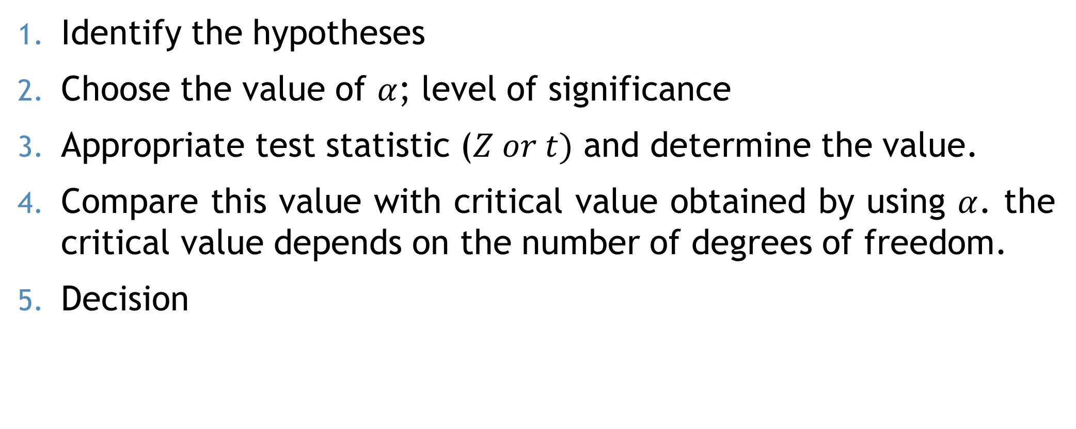


Steps (t Test)
$$t =\frac{\overline{X}−μ_{0}}{\frac{s}{\sqrt{n}}}$$
$$Z =\frac{\overline{X}−μ_{0}}{\frac{σ}{\sqrt{n}}}$$
Identify the hypotheses
Choose the value of $α$; level of significance
Appropriate test statistic ($Z or t)$ and determine the value.
Compare this value with critical value obtained by using $α$. the critical value depends on the number of degrees of freedom.
Decision
Decision: We may reject $H_{0}$ if,
For left tailed: $t_{cal}≤{−(t}_{α,DF})$
For right tailed: $t_{cal}≥{+(t}_{α,DF})$
For two tailed: $\left|t_{cal}\right|≥t_{\frac{α}{2},DF}$

Slide 3
Degrees of Freedom
Degrees of freedom are the maximum number of logically independent values, which may vary in a data sample.

Slide 4
Degrees of Freedom
Consider a data sample consisting of five integers.
The values of the five integers must have an average of six.
We can consider four independent values; this number, four, represents the degrees of freedom.

Slide 5
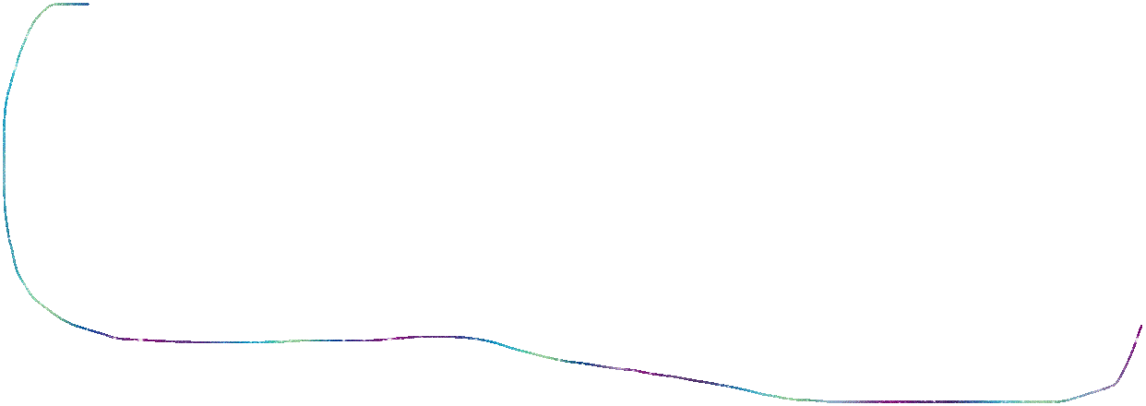





Degrees of Freedom
Difference between total sample and total number of parameters used in the test.
$$H_{0}: μ=μ_{0}$$
$$t =\frac{\overline{X}−μ_{0}}{\frac{s}{\sqrt{n}}}$$
There is one parameter
$$n$$
$$−$$
$$1$$
Sample size = n
Degrees of Freedom

Slide 6







Degrees of Freedom
Difference between total sample and total number of parameters used in the test.
$$H_{0}: μ_{1}=μ_{2}$$
$$n_{1}$$
$$n_{2}$$
There are two parameter
$$n_{1}+n_{2}$$
$$−$$
$$2$$
Sample size $=n_{1}+n_{2}$
Degrees of Freedom

Slide 7
Degrees of Freedom
Difference between total sample and total number of parameters used in the test.
$$H_{0}: μ=μ_{0}$$
$$t =\frac{\overline{X}−μ_{0}}{\frac{s}{\sqrt{n}}}$$
There is one parameter
$$n$$
$$−$$
$$1$$
Sample size = n
Degrees of Freedom

Slide 8

Recap…
$$t =\frac{\overline{X}−μ_{0}}{\frac{s}{\sqrt{n}}}$$
$$Z =\frac{\overline{X}−μ_{0}}{\frac{σ}{\sqrt{n}}}$$
Identify the hypotheses
Choose the value of $α$; level of significance
Appropriate test statistic ($Z or t)$ and determine the value.
Compare this value with critical value obtained by using $α$. the critical value depends on the number of degrees of freedom.
Decision
$$df=\left(n−1\right)$$
Decision: We may reject $H_{0}$ if,
For left tailed: $t_{cal}≤{−(t}_{α,DF})$
For right tailed: $t_{cal}≥{+(t}_{α,DF})$
For two tailed: $\left|t_{cal}\right|≥t_{\frac{α}{2},DF}$

Slide 9
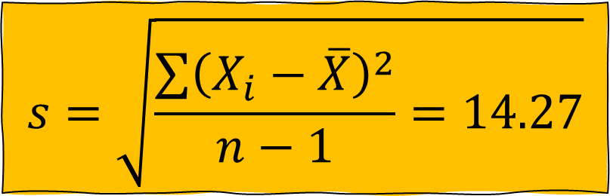

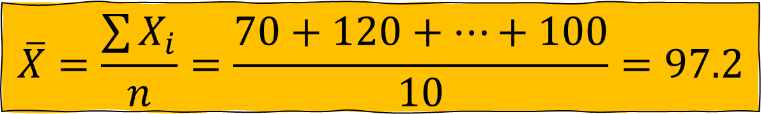

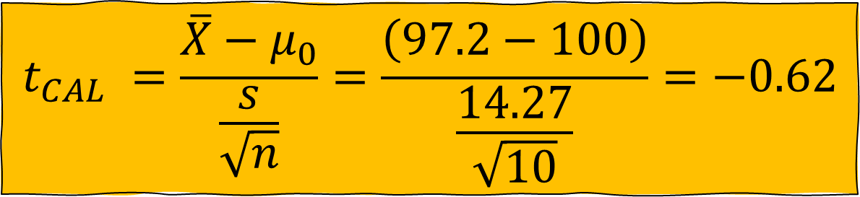


Example
$$H_{0}:μ=100$$
$$H_{1}:μ≠100$$
$$α=0.05$$
A random sample of 10 boys had the following I. Q’s: 70, 120, 110, 101, 88, 83, 95, 98, 107, 100. Do these data support the assumption of a population mean I. Q. of 100?
$$t_{CAL} =\frac{\overline{X}−μ_{0}}{\frac{s}{\sqrt{n}}}$$
$$t_{CAL} =\frac{\overline{X}−μ_{0}}{\frac{s}{\sqrt{n}}}=\frac{\left(97.2−100\right)}{\frac{14.27}{\sqrt{10}}}=−0.62$$
$$s=\sqrt{\frac{\sum{{\left(X_{i}−\overline{X}\right)}^{2}}}{n−1}=14.27}$$
$$\overline{X}=\frac{\sum{X_{i}}}{n}=\frac{70+120+…+100}{10}=97.2$$

Slide 10









Example
$$H_{0}:μ=100$$
$$t_{CAL} =\frac{\overline{X}−μ_{0}}{\frac{s}{\sqrt{n}}}=−0.62$$
$$H_{1}:μ≠100$$
$$α=0.05$$
A random sample of 10 boys had the following I. Q’s: 70, 120, 110, 101, 88, 83, 95, 98, 107, 100. Do these data support the assumption of a population mean I. Q. of 100?
$$t_{TAB}=t\left(\frac{α}{2},DF\right)$$
$$t_{TAB}=t\left(0.025,DF\right)$$
$$t_{TAB}=t\left(0.025,\left(n−1\right)\right)$$
$$t_{TAB}=t\left(0.025,9\right)$$
$$t_{TAB}=2.262$$
Decision: We may reject $H_{0}$ if,
For left tailed: $t_{cal}≤{−(t}_{α,DF})$
For right tailed: $t_{cal}≥{+(t}_{α,DF})$
For two tailed: $\left|t_{cal}\right|≥t_{\frac{α}{2},DF}$
$$\left|t_{CAL}\right|<t_{TAB}$$
$$May not reject H_{0}$$

Slide 11
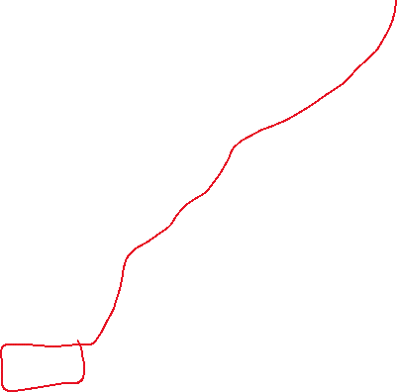







Example
$$H_{0}:μ=110$$
$$t_{CAL} =\frac{\overline{X}−μ_{0}}{\frac{s}{\sqrt{n}}}$$
$$H_{1}:μ<110$$
$$α=0.01$$
Is the temperature required to damage a computer on the average less than 110 degrees? Because of the price of testing, twenty computers were tested to see what minimum temperature will damage the computer. The damaging temperature averaged 109 degrees with a standard deviation of 3 degrees. (Use 99% confidence level)

Slide 12
Errors in Test
Any decision we make based on a hypothesis test may be incorrect
Because we have used partial information obtained from a sample to draw conclusion about the entire population.

Slide 13
Errors in Test
Two types of error can be made
Type I error
Type II error

Slide 14

Type I Error
$$α$$
The probability of rejecting null hypothesis when it is true.
For example, Let's say a medical researcher is conducting a clinical trial to test a new drug's effectiveness in treating a certain condition. Null hypothesis is “The drug has no effect”, and alternative is “The drug has effect”.
If, in reality, the drug has no effect (null hypothesis is true), but the statistical analysis leads the researcher to reject the null hypothesis, it would be a Type I error.

Slide 15

Type II Error
$$β$$
The probability of accepting null hypothesis when it is false.
For example, Let's say a medical researcher is conducting a clinical trial to test a new drug's effectiveness in treating a certain condition. Null hypothesis is “The drug has no effect”, and alternative is “The drug has effect”.
If, in reality, the drug has effect (null hypothesis is true), but the statistical analysis leads the researcher to accept the null hypothesis, it would be a Type II error.

Slide 16
Type I and II
 | Actual situation
Decision from sample

Slide 17
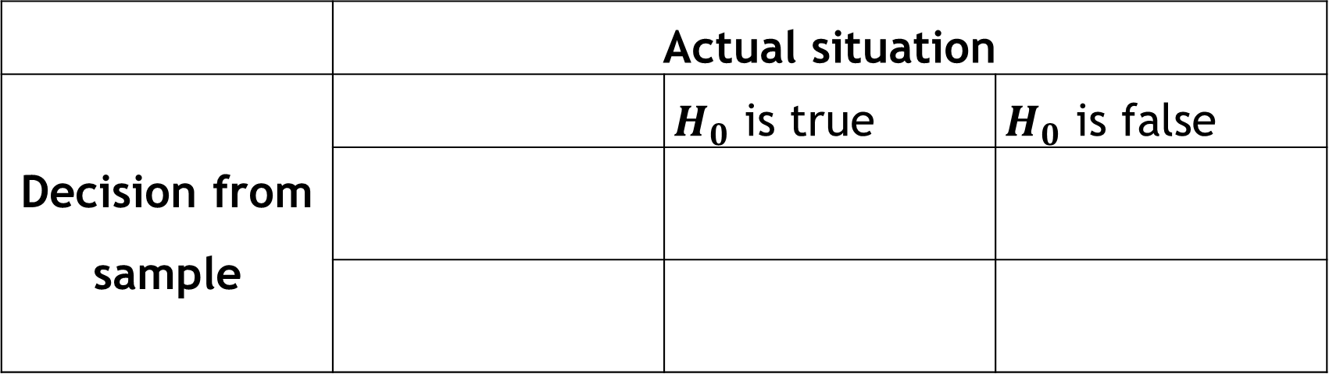
Type I and II
 | Actual situation
Decision from sample |  | $H_{0}$ is true | $H_{0}$ is false

Slide 18
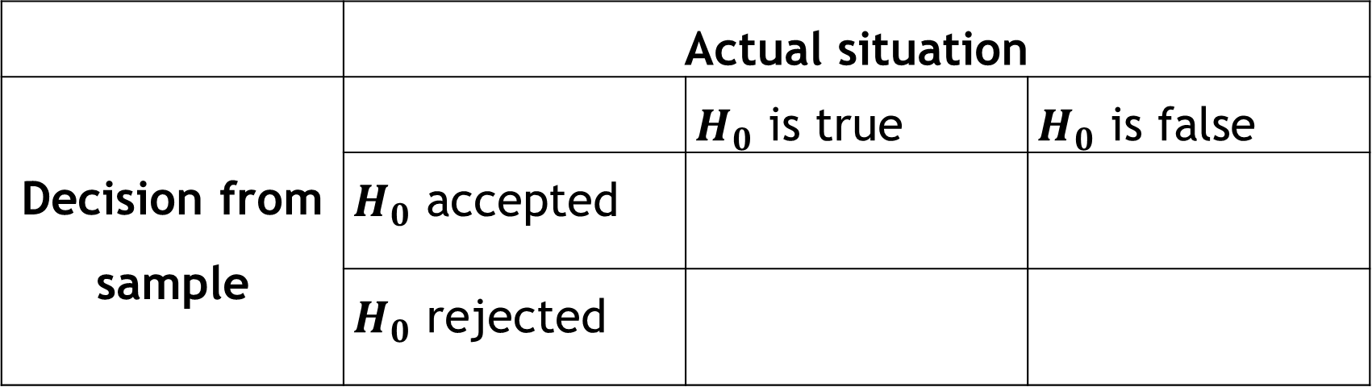
Type I and II
 | Actual situation
Decision from sample |  | $H_{0}$ is true | $H_{0}$ is false
 | $H_{0}$ accepted
 | $H_{0}$ rejected

Slide 19
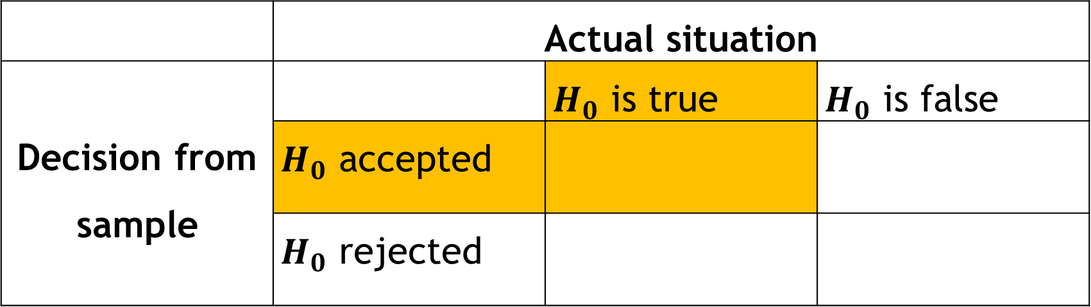
Type I and II
 | Actual situation
Decision from sample |  | $H_{0}$ is true | $H_{0}$ is false
 | $H_{0}$ accepted
 | $H_{0}$ rejected

Slide 20
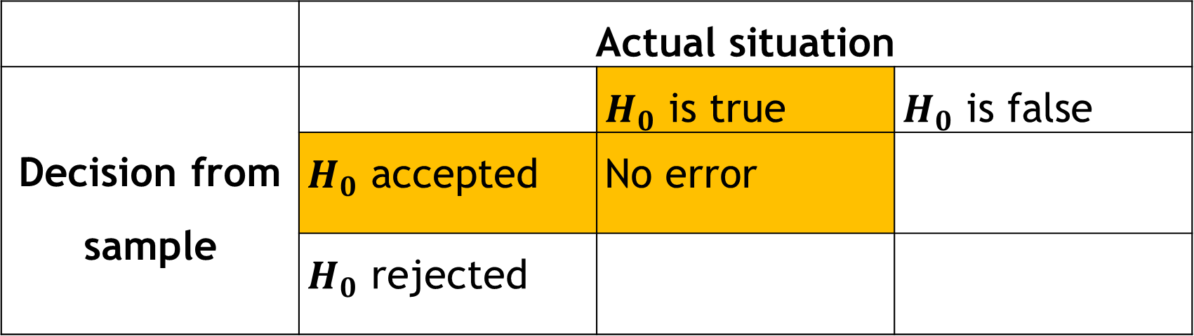
Type I and II
 | Actual situation
Decision from sample |  | $H_{0}$ is true | $H_{0}$ is false
 | $H_{0}$ accepted | No error
 | $H_{0}$ rejected

Slide 21
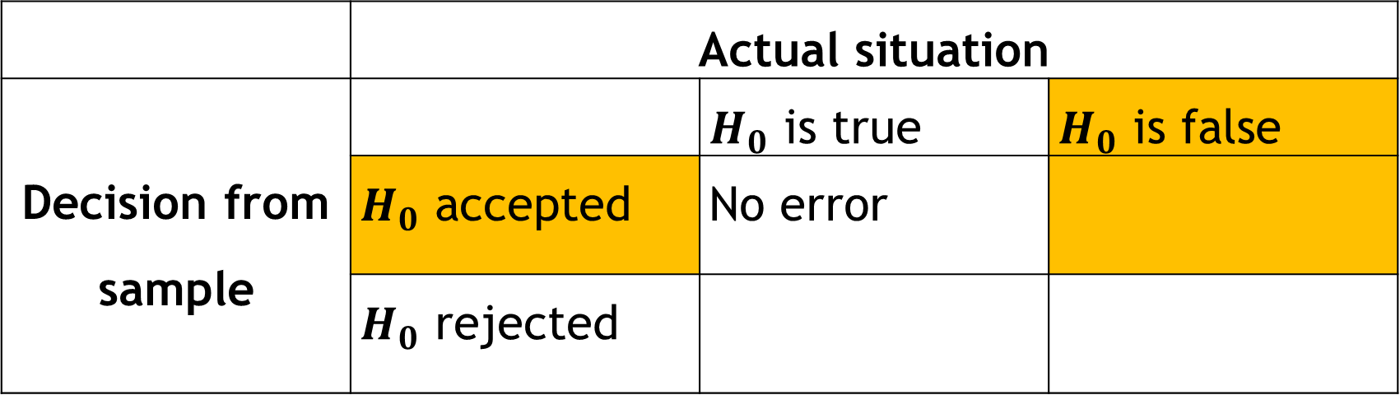
Type I and II
 | Actual situation
Decision from sample |  | $H_{0}$ is true | $H_{0}$ is false
 | $H_{0}$ accepted | No error
 | $H_{0}$ rejected

Slide 22
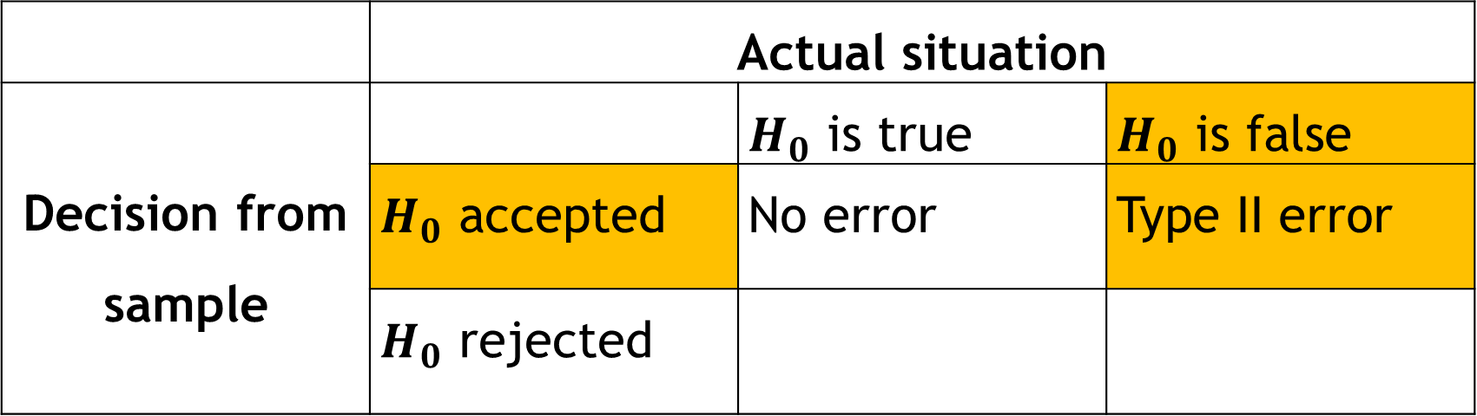
Type I and II
 | Actual situation
Decision from sample |  | $H_{0}$ is true | $H_{0}$ is false
 | $H_{0}$ accepted | No error | Type II error
 | $H_{0}$ rejected

Slide 23
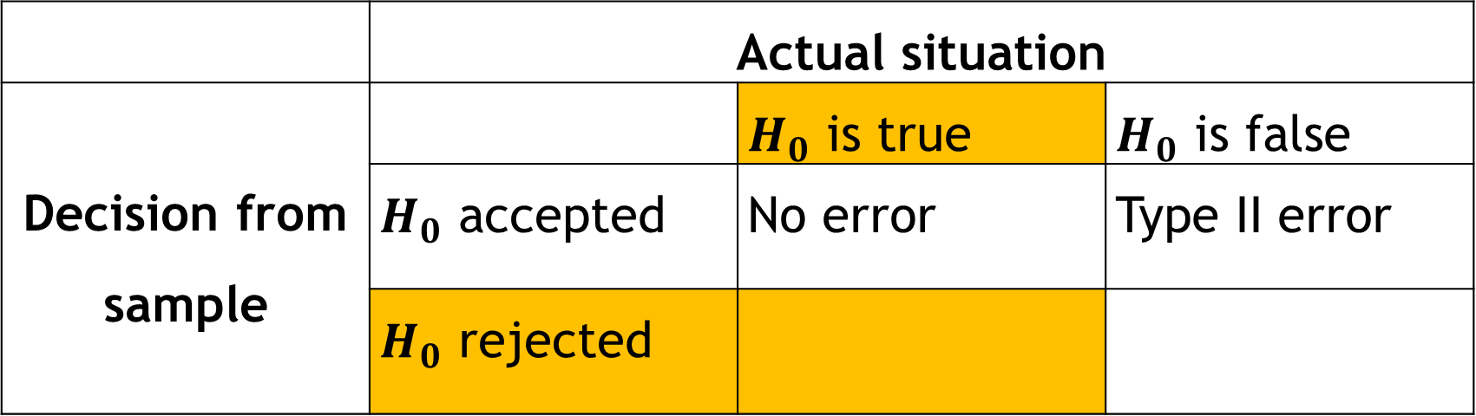
Type I and II
 | Actual situation
Decision from sample |  | $H_{0}$ is true | $H_{0}$ is false
 | $H_{0}$ accepted | No error | Type II error
 | $H_{0}$ rejected

Slide 24
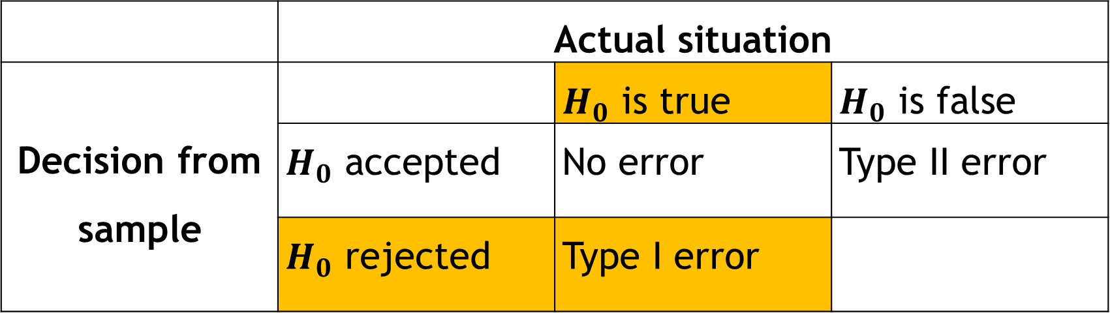
Type I and II
 | Actual situation
Decision from sample |  | $H_{0}$ is true | $H_{0}$ is false
 | $H_{0}$ accepted | No error | Type II error
 | $H_{0}$ rejected | Type I error

Slide 25
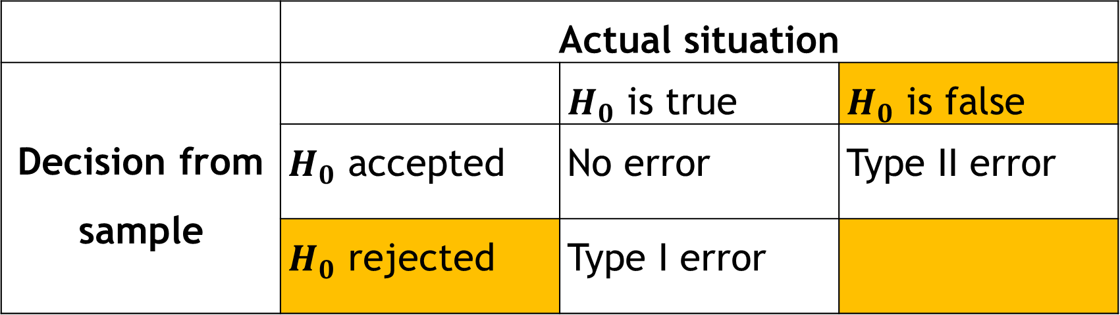
Type I and II
 | Actual situation
Decision from sample |  | $H_{0}$ is true | $H_{0}$ is false
 | $H_{0}$ accepted | No error | Type II error
 | $H_{0}$ rejected | Type I error

Slide 26
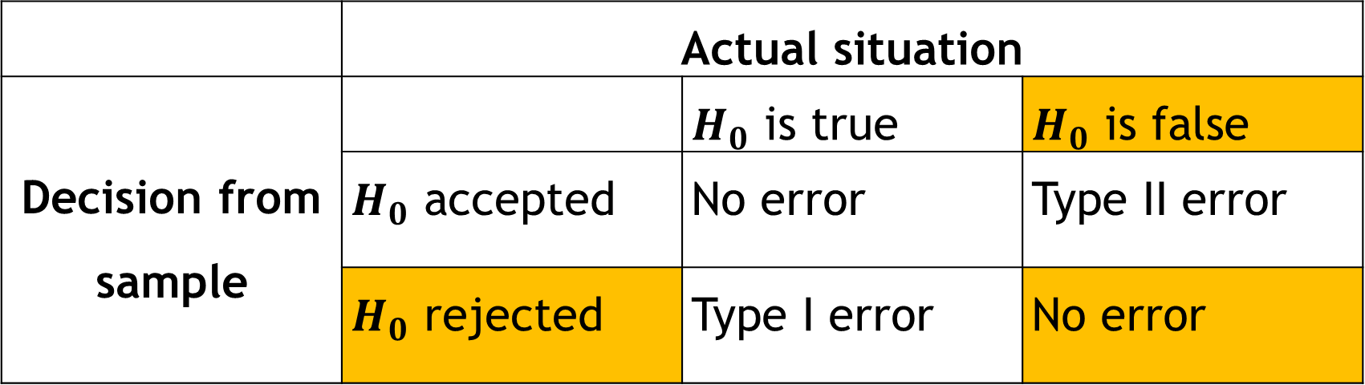
Type I and II
 | Actual situation
Decision from sample |  | $H_{0}$ is true | $H_{0}$ is false
 | $H_{0}$ accepted | No error | Type II error
 | $H_{0}$ rejected | Type I error | No error

Slide 27
Reduce errors
We can reduce type II error by increasing sample size.
We can reduce type I error by decreasing level of significance.

Slide 28


P-value
For left tailed: $p value=P\left(Z_{cal}\right)$
For right tailed: $p value=1−P\left(Z_{cal}\right)$
For two tailed: $p value=2×(1−P(\left|Z_{cal}\right|)$
Probability value (P-value)
A measure used in statistical hypothesis testing
To quantify the evidence against a null hypothesis.
If $P$-$value<α$, we may reject $H_{0}$

Slide 29

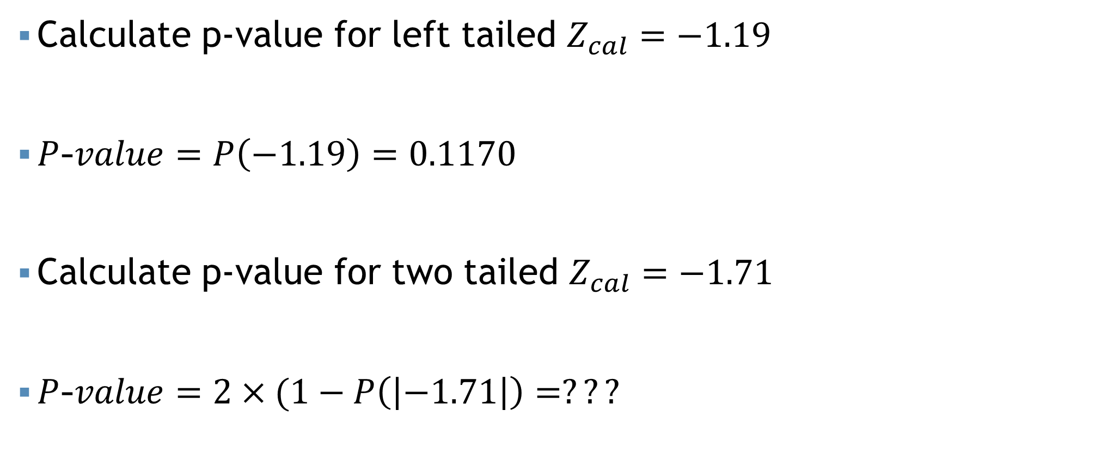
P-value
If $P$-$value<α$, we may reject $H_{0}$
Calculate p-value for left tailed $Z_{cal}=−1.19$
$P$-$value=P\left(−1.19\right)=0.1170$
Calculate p-value for two tailed $Z_{cal}=−1.71$
$P$-$value=2×(1−P\left(\left|−1.71\right|\right)=???$
Left tailed test
Two tailed test

Slide 30
Mathematical exercise
To access additional mathematical problems, please refer to the PDF lecture notes.

Slide 31
Thank You

